Slide 1

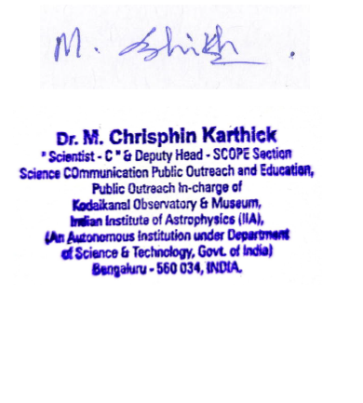
Dr. M. Chrisphin Karthick
Scientist " C ", Indian Institute of Astrophysics (IIA)
Outreach In-Charge, Kodaikanal Observatory
Bengaluru 560 034, INDIA
E-mail: chrisphin.karthick@iiap.res.in
Date: 14.07.2025
INTERNSHIP CERTIFICATE
This is to certify that G. Dhanush Kumar, Reg. No: 9517202202022, IV B.E Electrical and Electronics Engineering, Mepco Schlenk Engineering College, Sivakasi has satisfactorily fulfilled the requirements of his internship from 09/06/2025 to 14/06/2025. He has done his internship titled “ A Study on Radio Astronomy and its Applications ” under my supervision. The intern’s attendance and conduct are good throughout the internship.
Yours Sincerely,

